Slide 1

Carotid Plaque Characterization with Medical Ultrasound
Matthew M. McCormick
Under the supervision of Dr. Tomy Varghese
A dissertation submitted in partial fulfillment of the requirements for the degree of
Doctor of Philosophy
(Department of Biomedical Engineering)
UNIVERSITY OF WISCONSIN-MADISON
April 7, 2011

Slide 2
The Problem: Stroke
Stroke is the loss of brain function due to hypoxia.
Effects of a stroke include impaired movement, speech, cognition, or death.
Very prevalent, in the United States¹:
Leading cause of serious, long-term disability.
780,000 new cases in 2005.
Third leading cause of death.
150,000 deaths in 2004.
$43.7 billion dollars in direct medical costs in 2008.
¹American Heart Association. Heart disease and stroke statistics – 2008 update. Online.

Slide 3
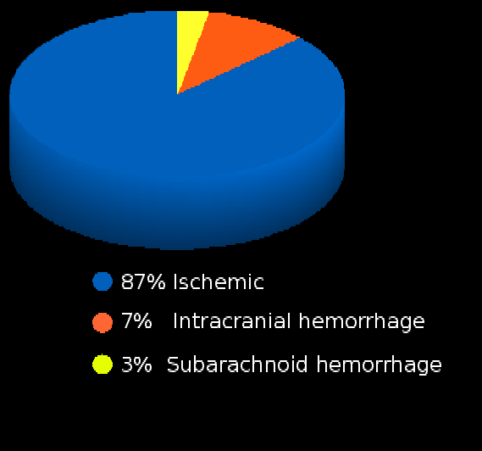
Etiology of Stroke
Stroke can be caused by subarachnoid hemorrhage or intracranial hemorrhage, but ischemic stroke is the most common.
Ischemic stroke can occur through a hemodynamic, thrombotic, or embolic mechanism.
¹American Heart Association. Heart disease and stroke statistics – 2008 update. Online.

Slide 4
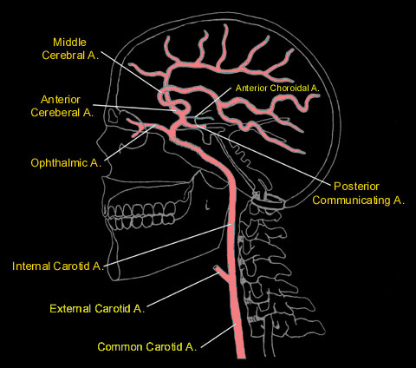
Etiology of Stroke
Emboli have many origins.
Atrial fibrillation
Congestive heart failure
Mechanical heart valve
Patent foramen ovale
Plaque fragments or thrombi originating from the carotid artery
Image source: http://www.meddean.luc.edu/lumen/MedEd/neuro/neurovasc/navigation/ica.htm

Slide 5
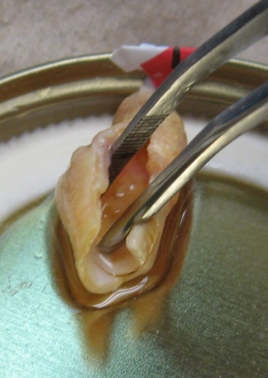
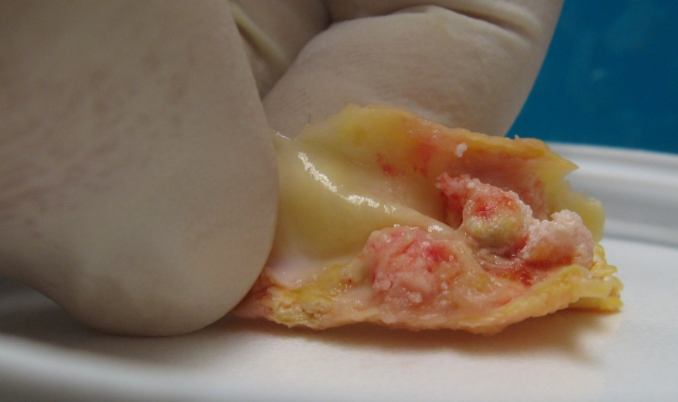
Differentiating high risk carotid plaques
Plaque accumulates in the larger arteries throughout our lives.
The carotid bifurcation is particularly susceptible to accumulation.
Although many people will accumulate plaque, only a few will develop ischemic symptoms.

Slide 6
Differentiating high risk carotid plaques
The purpose of this research:
Development of a method to identify and differentiate high risk plaque.

Slide 7
Factors that increase risk
Increased hemodynamic forces
Hypertension
Cyclic loading
Stress concentrators
Material inhomogeneity
Morphological irregularity
Ulceration
Vasa vasorum
Weak materials
Inflammation and enzymes such as matrix metalloproteinase-9.
Weak constituents such as lipid or fresh hemorrhage.

Slide 8
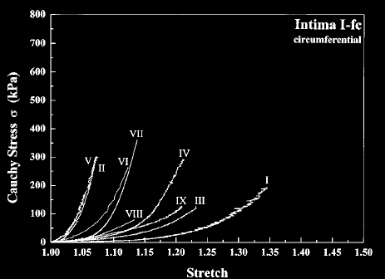
Proposed method for assessing risk
Image plaque strain.
Quantifies local compression and stretching experienced by tissue.
Measured with the spatial gradient of the tissue displacement.
Figure taken from G.A. Holzapel, G. Sommer, and P. Regitnig. Anisotropic mechanical properties of tissue components in human atherosclerotic plaques. Journal of Biomechanical Engineering – Transactions of the ASME. 126(5):657-665, 2004.

Slide 9
Proposed method for assessing Risk
Directly measures how close tissue is to failure/ rupture.
High hemodynamic forces and intense stress concentrators result in high strains.
Lipid and hemorrhage, weaker materials, also have low elastic moduli and will have high strains.
Figure taken from G.A. Holzapel, G. Sommer, and P. Regitnig. Anisotropic mechanical properties of tissue components in human atherosclerotic plaques. Journal of Biomechanical Engineering – Transactions of the ASME. 126(5):657-665, 2004.
Notes:
9

Slide 10
Specific Aims
Aim 1: Non-invasive ultrasonic carotid plaque strain imaging for stroke risk assessment.
Aim 2: In vitro ultrasonic high frequency plaque characterization.
Aim 3: Transcranial Doppler detection of microemboli.

Slide 11
Strain imaging algorithm Overview
Displacement Images
Strain Images
Cardiac Cycle Accumulation
Strain Metrics
Notes:
11

Slide 12
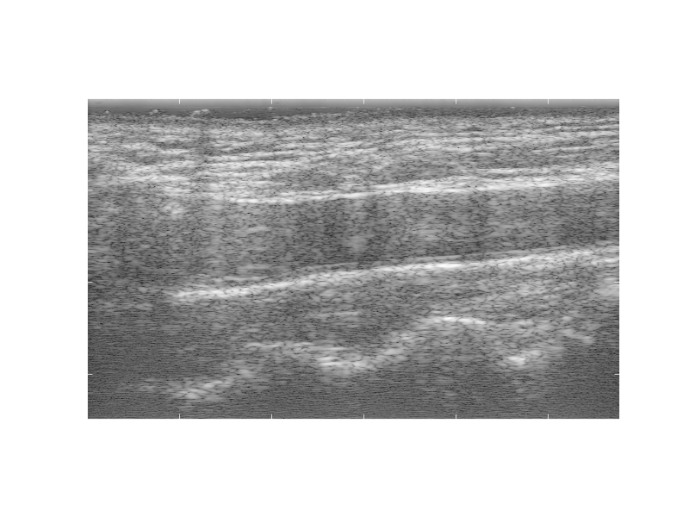
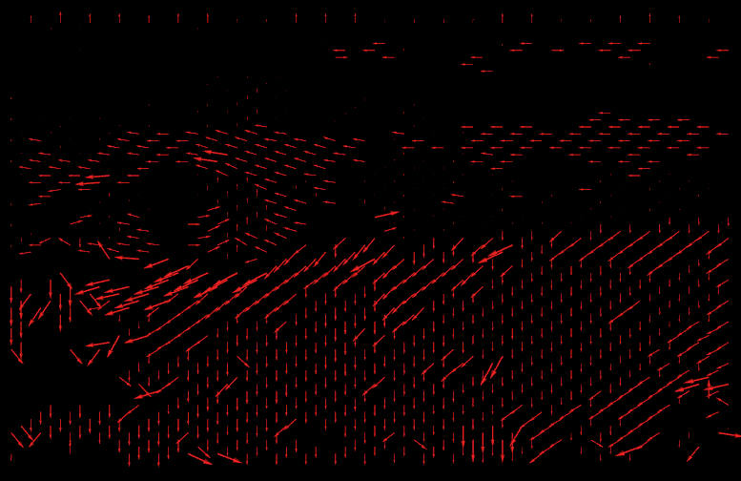

Strain imaging algorithm Block-matching motion tracking
Pre-deformation
image
Displacement field
Displacement Images
Post-deformation
image
Strain Images
Cardiac Cycle Accumulation
Strain Metrics
Notes:
12

Slide 13
Strain imaging algorithm Block-matching motion tracking
Pre-deformation
image
Displacement Images
Post-deformation
image
Strain Images
Cardiac Cycle Accumulation
Strain Metrics
Notes:
13

Slide 14
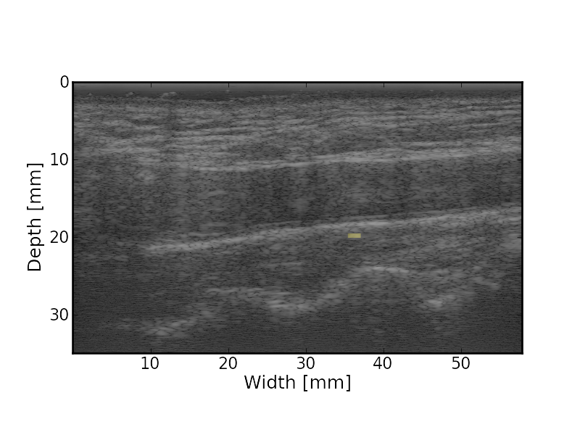
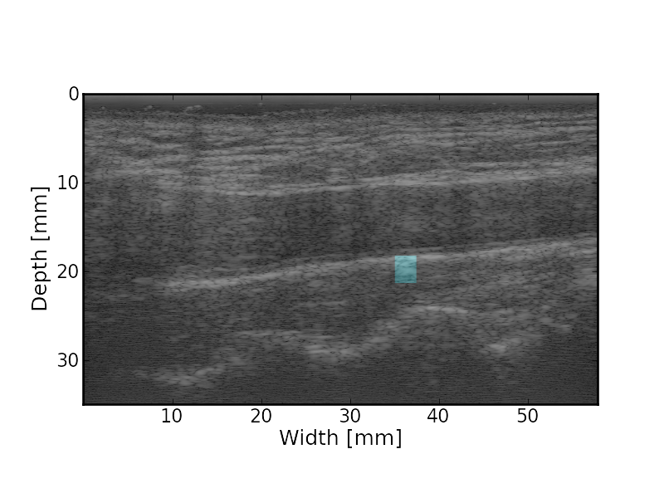
Strain imaging algorithm Block-matching motion tracking
Pre-deformation
image
Matching
Kernel
Displacement Images
Post-deformation
image
Search
Region
Strain Images
Cardiac Cycle Accumulation
Strain Metrics
Notes:
14

Slide 15
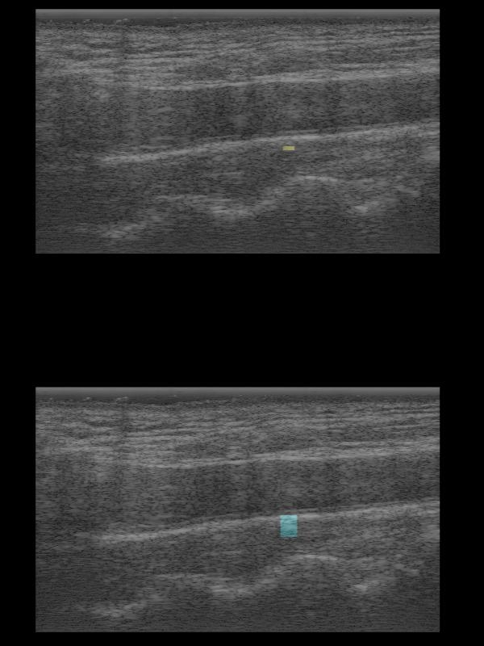
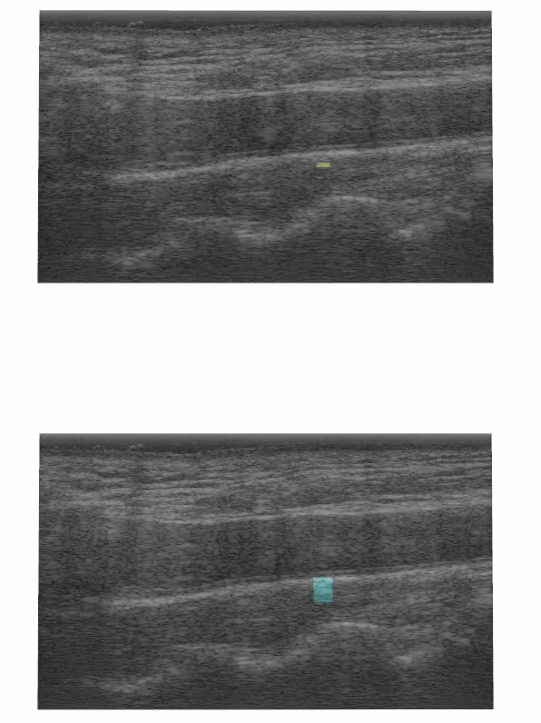
Strain imaging algorithm Block-matching motion tracking
Matching
Kernel
Displacement Images
Search
Region
Strain Images
Cardiac Cycle Accumulation
Strain Metrics
Notes:
15

Slide 16
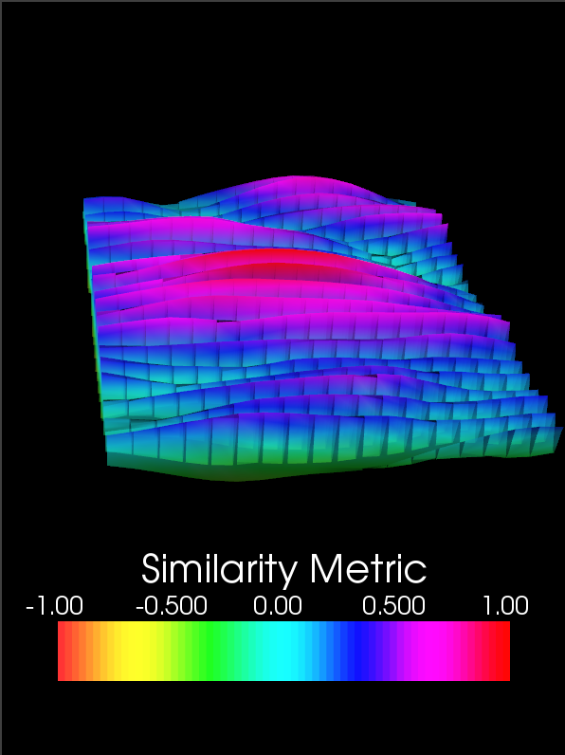
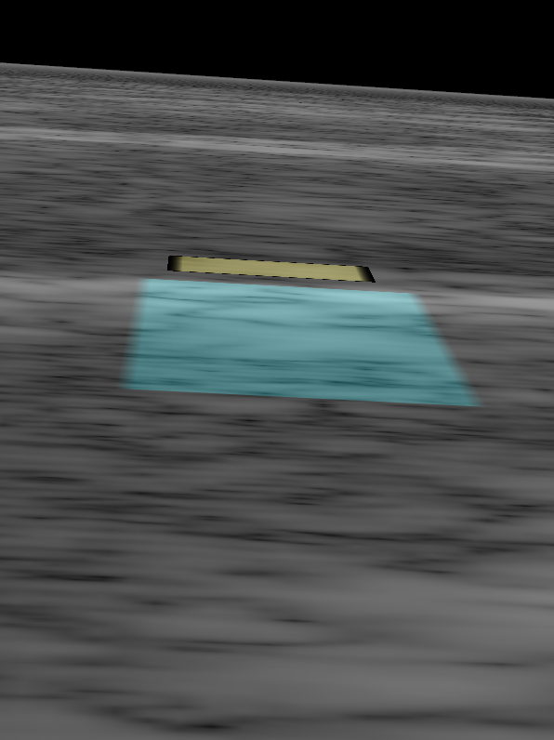
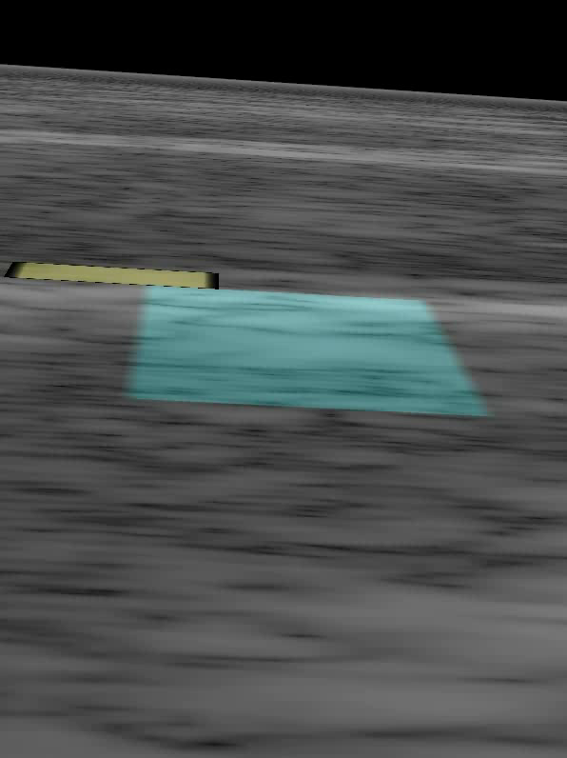
Strain imaging algorithm Block-matching motion tracking
Displacement Images
Strain Images
Cardiac Cycle Accumulation
Strain Metrics
Notes:
16

Slide 17
Strain imaging algorithm Block-matching motion tracking
Displacement Images
Strain Images
Cardiac Cycle Accumulation
Strain Metrics
Notes:
17

Slide 18
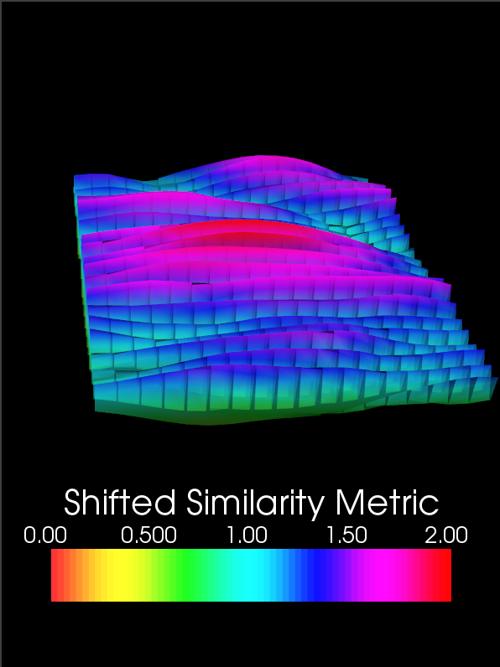
Strain imaging algorithm Noise resistance with Bayesian regularization
Shift by theoretical lower bound
Displacement Images
Strain Images
Cardiac Cycle Accumulation
Strain Metrics
Notes:
18

Slide 19
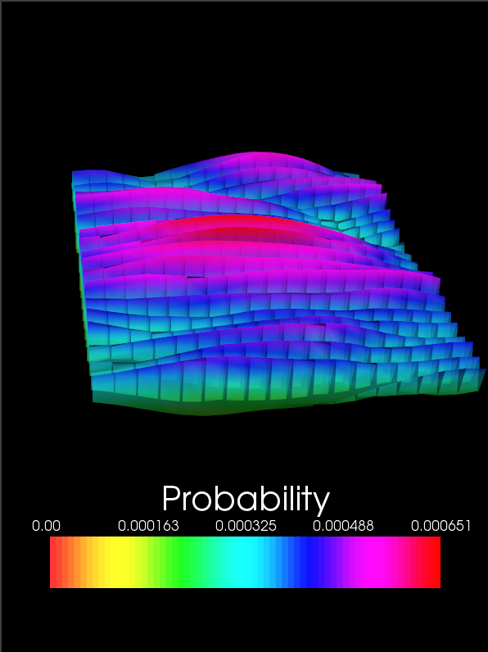
Strain imaging algorithm Block-matching motion tracking
Shift by theoretical lower bound
Normalize such that the values sum to one
Displacement Images
Strain Images
Cardiac Cycle Accumulation
Strain Metrics
Notes:
19

Slide 20
Strain imaging algorithm Block-matching motion tracking
Shift by theoretical lower bound
Normalize such that the values sum to one
Displacement Images
Strain Images
Cardiac Cycle Accumulation
Strain Metrics
Notes:
20

Slide 21



Strain imaging algorithm Noise resistance with Bayesian regularization
Recursive Bayesian Regularization
Displacement Images
Strain Images
Cardiac Cycle Accumulation
Strain Metrics
Notes:
21

Slide 22

Strain imaging algorithm Noise resistance with Bayesian regularization
Recursive Bayesian Regularization
Displacement Images
Strain Images
Cardiac Cycle Accumulation
Strain Metrics
Notes:
22

Slide 23
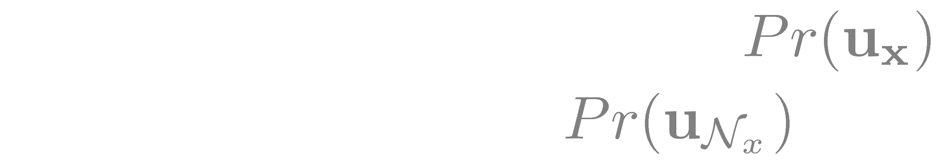
Strain imaging algorithm Noise resistance with Bayesian regularization
Recursive Bayesian Regularization
Displacement Images
Strain Images
Cardiac Cycle Accumulation
Strain Metrics
Notes:
23

Slide 24
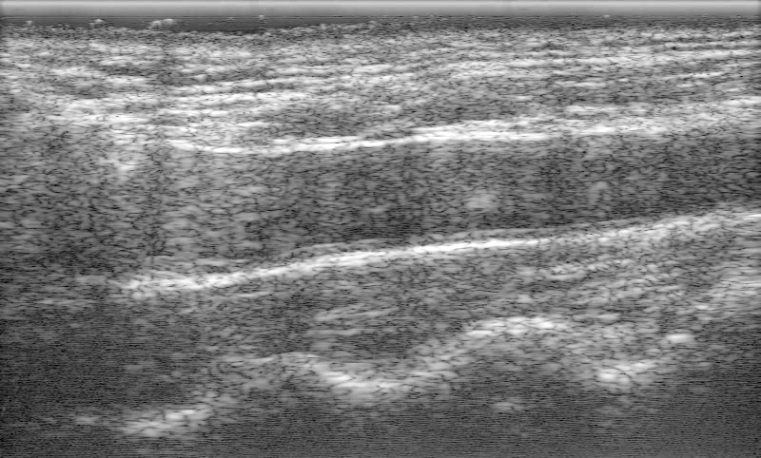
Strain imaging algorithm Bayesian regularization example: Removal of a reverberation
Displacement Images
Strain Images
Carotid artery
Cardiac Cycle Accumulation
Strain Metrics
Notes:
24

Slide 25
Strain imaging algorithm Bayesian regularization example: Removal of a reverberation
Displacement Images
Strain Images
Search Region
Cardiac Cycle Accumulation
Strain Metrics
Notes:
25

Slide 26
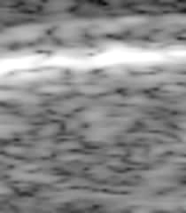
Strain imaging algorithm Bayesian regularization example: Removal of a reverberation
Displacement Images
Strain Images
Reverberation moving in the opposite direction of surrounding tissue
Cardiac Cycle Accumulation
Strain Metrics
Notes:
26

Slide 27
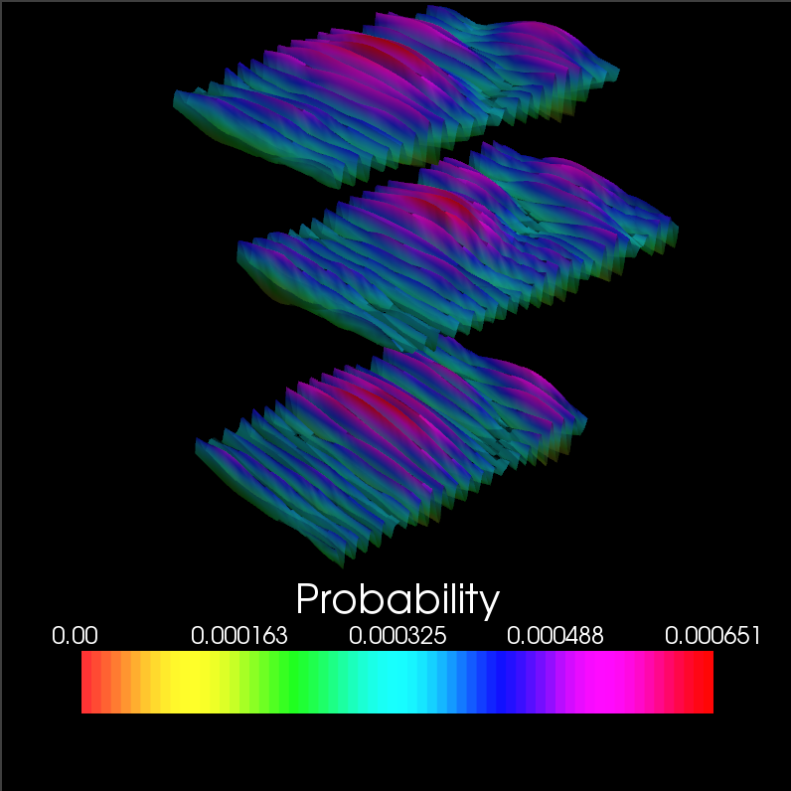
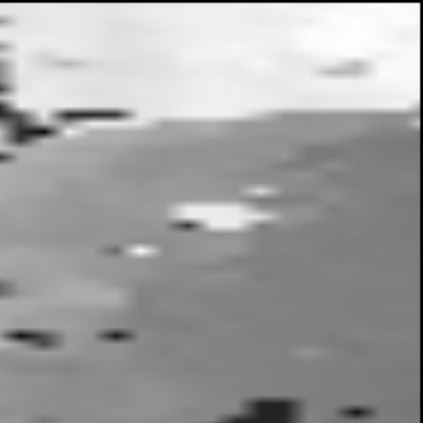
Strain imaging algorithm Bayesian regularization example: Removal of a reverberation
Regularization iteration 0
Block of interest
Lateral neighbor
Axial neighbor
Axial Displacement
Displacement Images
Strain Images
Cardiac Cycle Accumulation
B-Mode
Strain Metrics
Notes:
27

Slide 28
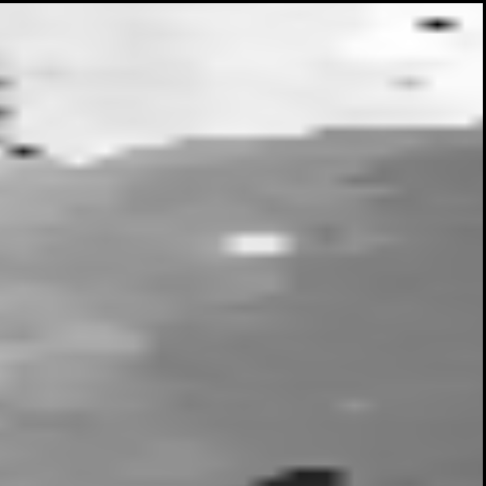
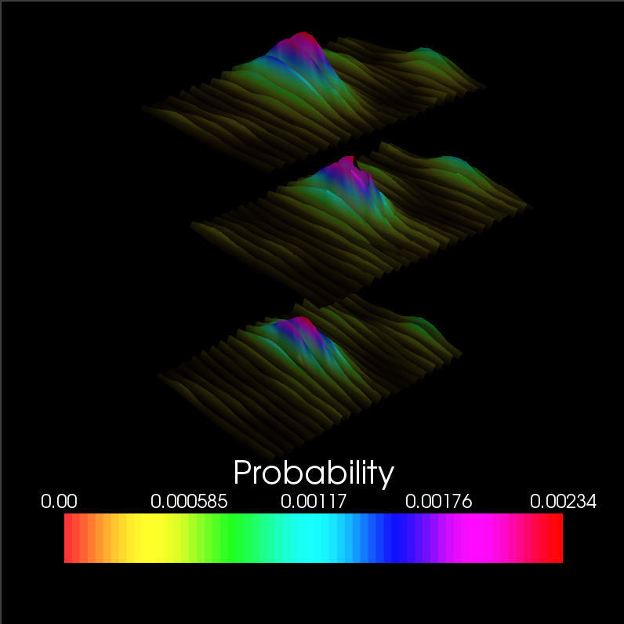
Strain imaging algorithm Bayesian regularization example: Removal of a reverberation
Regularization iteration 1
Block of interest
Lateral neighbor
Axial neighbor
Axial Displacement
Displacement Images
Strain Images
Cardiac Cycle Accumulation
B-Mode
Strain Metrics
Notes:
28

Slide 29
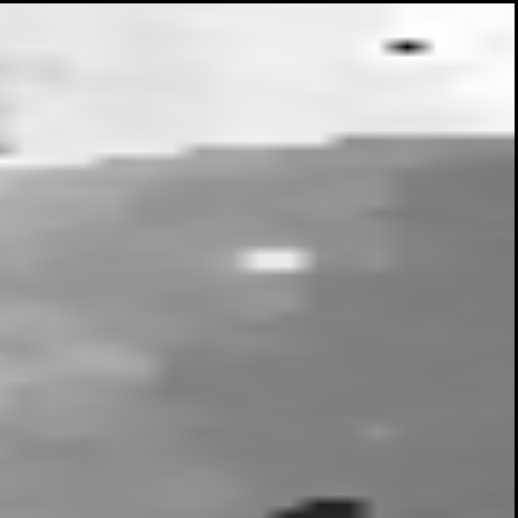
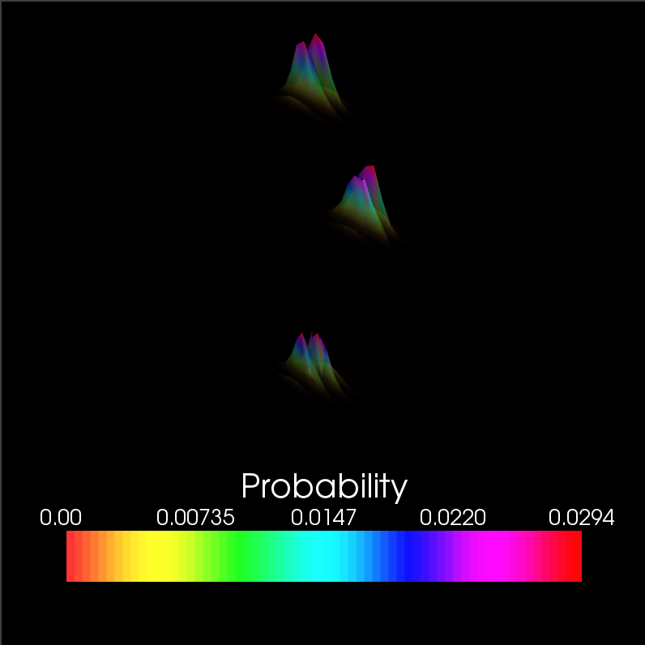
Strain imaging algorithm Bayesian regularization example: Removal of a reverberation
Regularization iteration 2
Block of interest
Lateral neighbor
Axial neighbor
Axial Displacement
Displacement Images
Strain Images
Cardiac Cycle Accumulation
B-Mode
Strain Metrics
Notes:
29

Slide 30
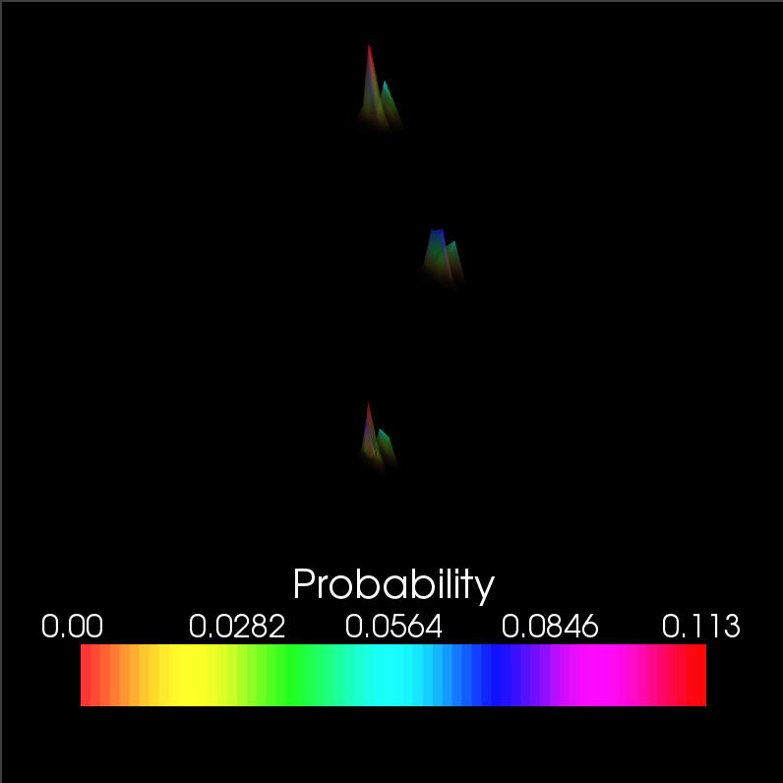
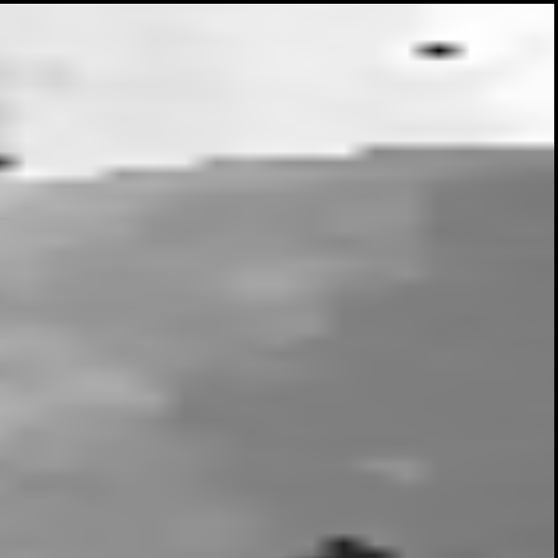
Strain imaging algorithm Bayesian regularization example: Removal of a reverberation
Regularization iteration 3
Block of interest
Lateral neighbor
Axial neighbor
Axial Displacement
Displacement Images
Strain Images
Cardiac Cycle Accumulation
B-Mode
Strain Metrics
Notes:
30

Slide 31
Strain imaging algorithm Multi-level motion tracking
Scale-space representation of RF-images
Filter by 2D Gaussian
Subsample
Use low-resolution tracked displacements to initialize higher resolution motion-tracking
Displacement Images
Strain Images
Cardiac Cycle Accumulation
Strain Metrics
Notes:
31

Slide 32
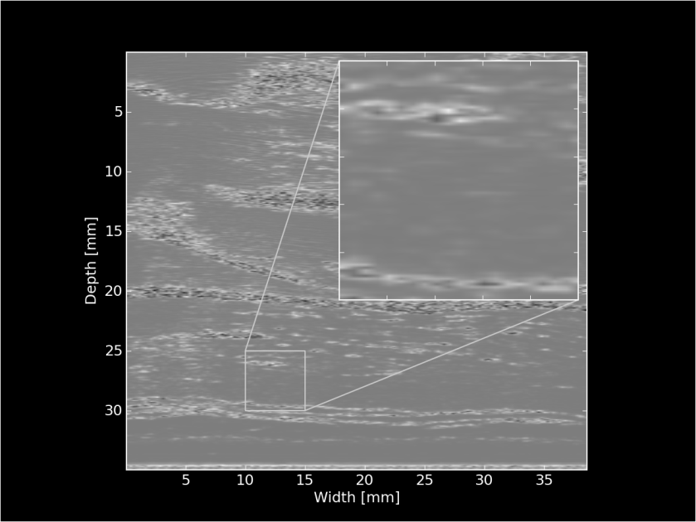
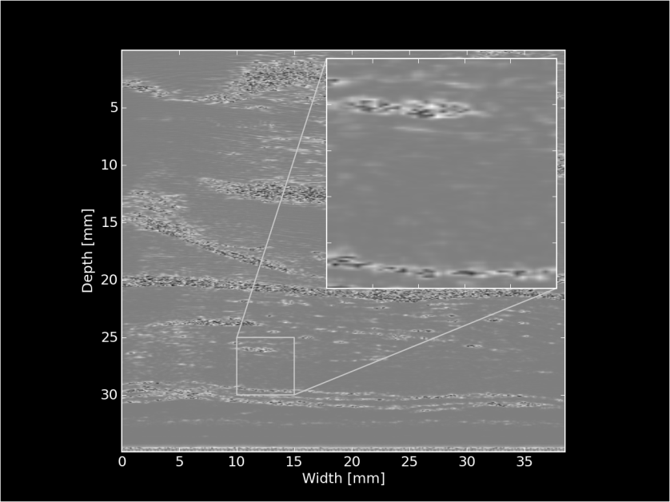
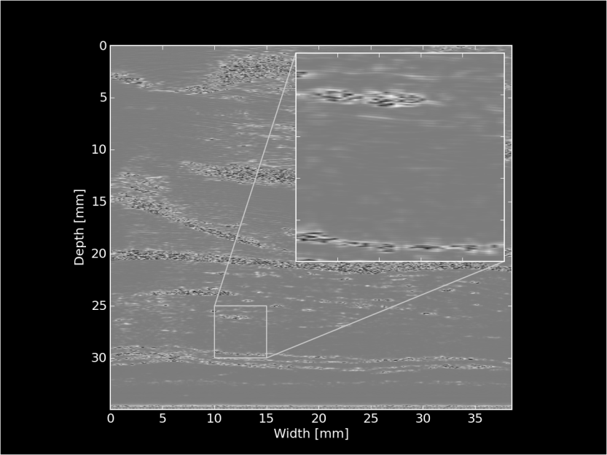
Strain imaging algorithm Multi-level motion tracking
Displacements
initialize search
Displacements
initialize search
Xxbyxx pixels
Xxbyxx pixels
Xxbyxx pixels
Displacement Images
Strain Images
Cardiac Cycle Accumulation
Strain Metrics
Notes:
32

Slide 33
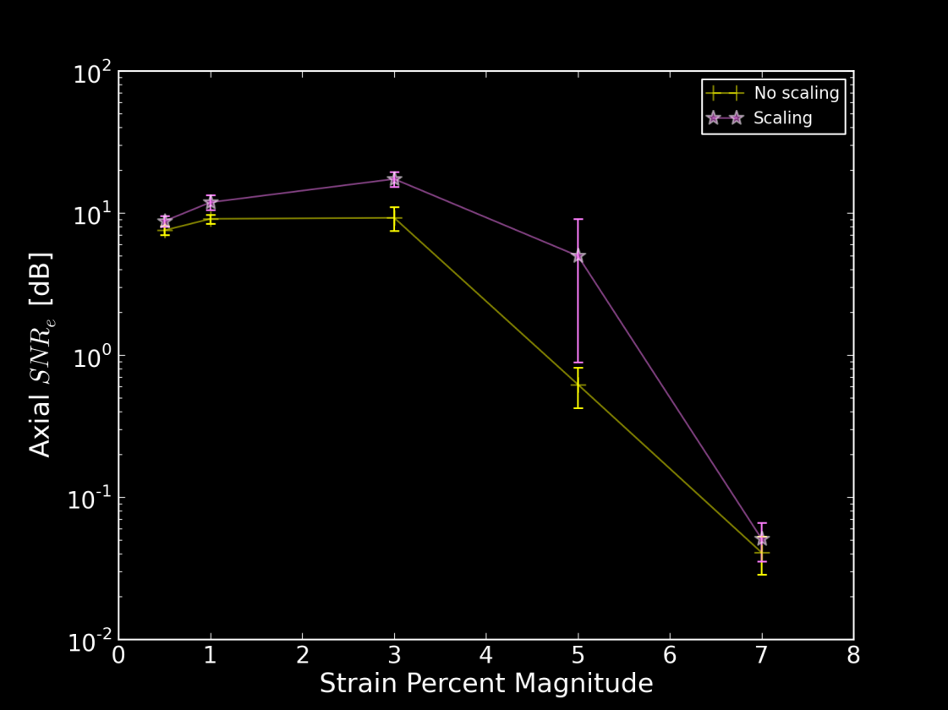
Strain imaging algorithm Multi-level motion tracking
Why?
Robustness
Avoid local minima (“peak-hopping”) in the similarity metric
Speed
Smaller search regions in higher resolution images
Stretch matching-block by prior strain results
Improve correlation
Displacement Images
Strain Images
Cardiac Cycle Accumulation
Strain Metrics
Notes:
33

Slide 34
Strain imaging algorithm Multi-level motion tracking
Displacements
initialize search
Displacements
initialize search
Xxbyxx pixels
Xxbyxx pixels
Xxbyxx pixels
Displacement Images
Strain Images
Displacement subsample
interpolation
Strain images?
Cardiac Cycle Accumulation
Strain Metrics
Notes:
34

Slide 35
Strain imaging algorithm Subsample interpolation
Objective: interpolate the similarity metric function to find subsample displacement of the matching block
Displacement Images
Strain Images
Cardiac Cycle Accumulation
Strain Metrics
Notes:
35

Slide 36
Strain imaging algorithm Subsample interpolation
Methods:
Parabolic interpolation
Fit a parabola to three point surrounding maximum sample
2D windowed-sinc interpolation with numerical optimization
Iteratively locate the subsample peak with unbiased interpolation
Displacement Images
Strain Images
Cardiac Cycle Accumulation
Strain Metrics
Notes:
36

Slide 37
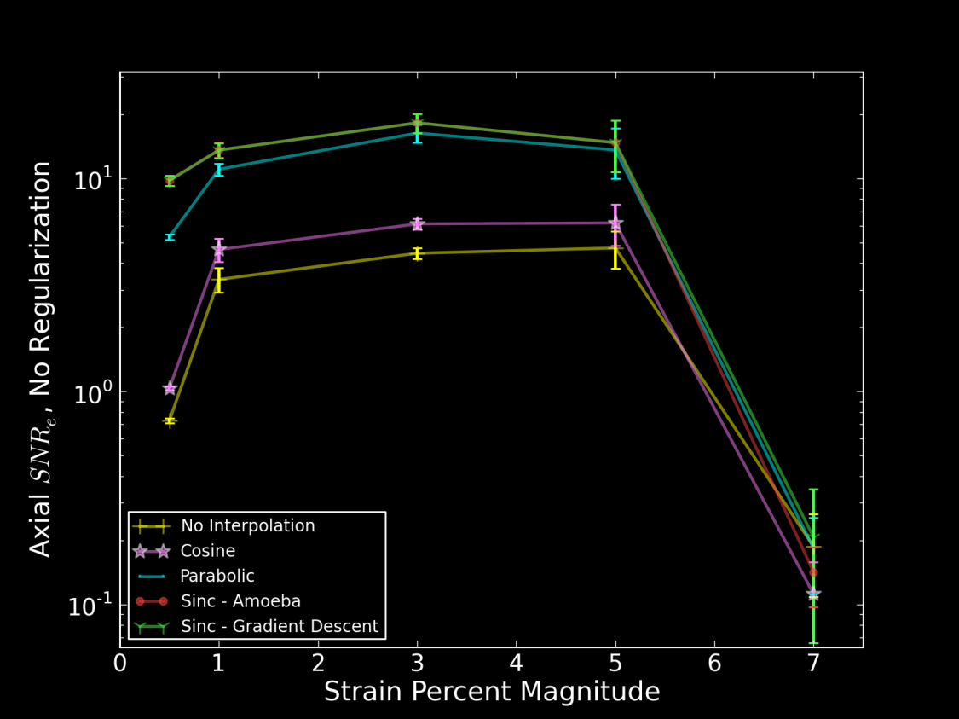
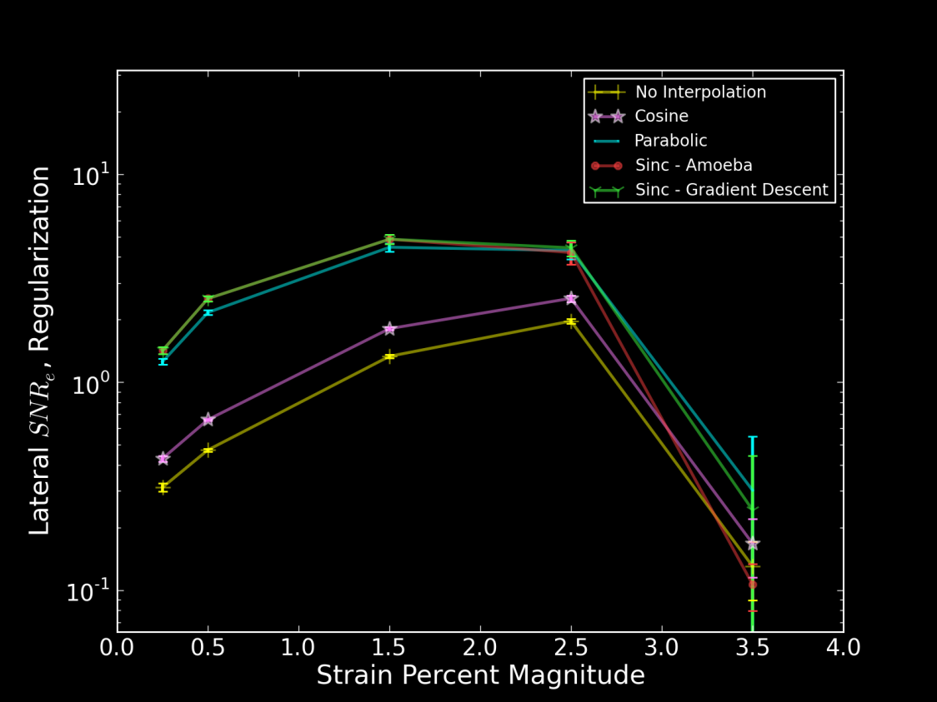
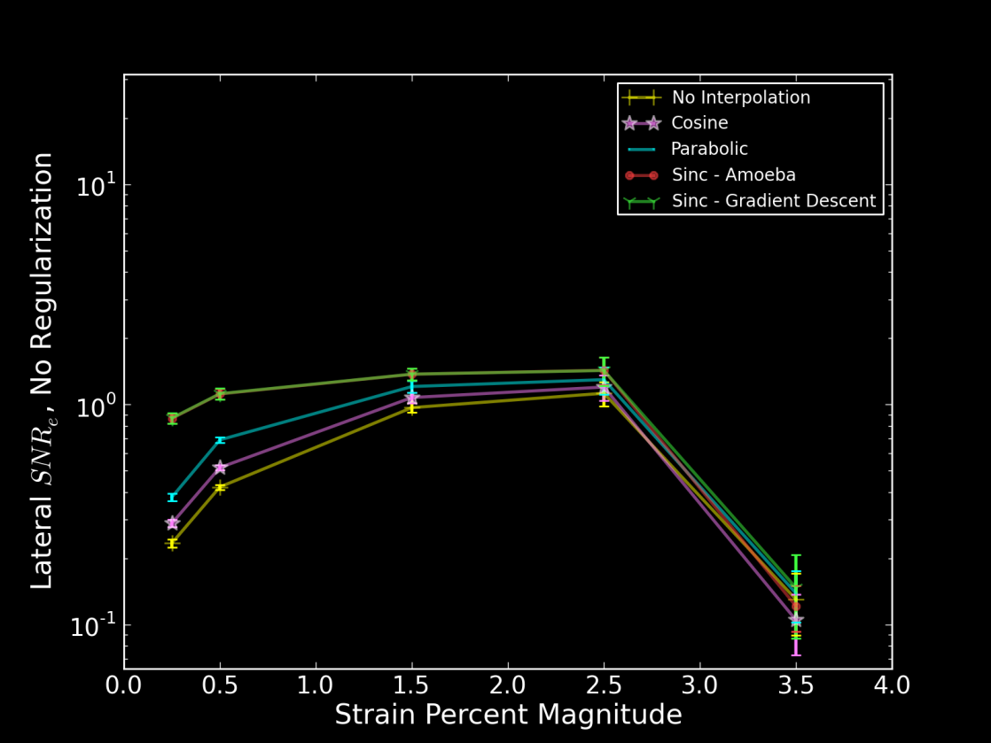
Strain imaging algorithm Subsample interpolation
Displacement Images
Strain Images
Cardiac Cycle Accumulation
Strain Metrics
Notes:
37

Slide 38
Strain imaging algorithm Strain: quantification of tissues’ mechanical distortion
Displacement Images
Strain Images
Cardiac Cycle Accumulation
Strain Metrics
Notes:
38

Slide 39
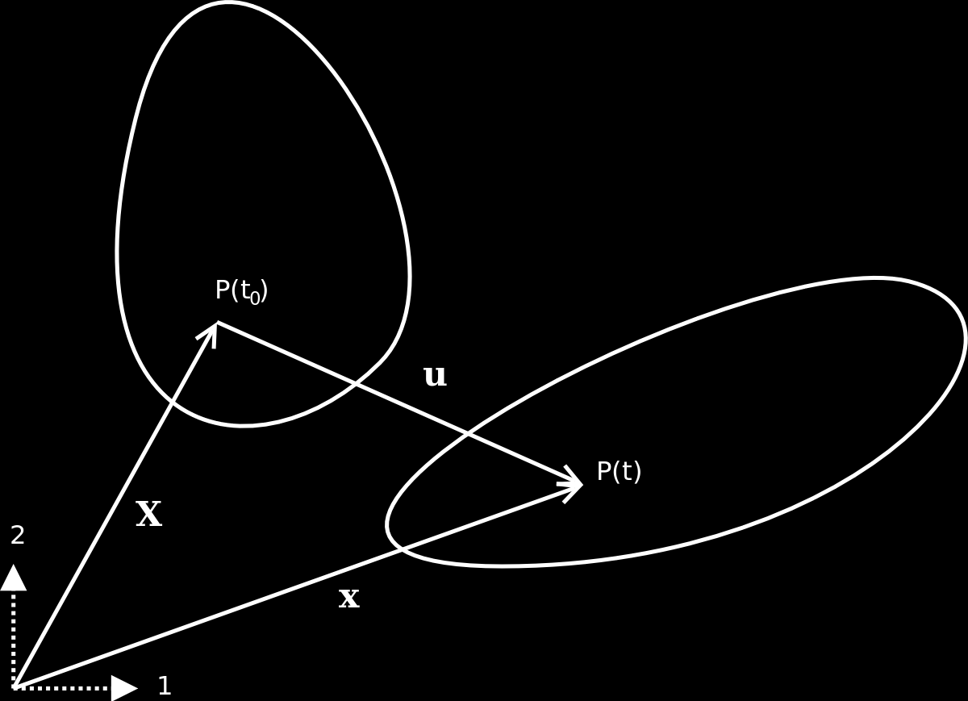
Strain imaging algorithm Strain: quantification of tissues’ mechanical distortion
Pre-deformation body
Post-deformation body
Displacement Images
Strain Images
Cardiac Cycle Accumulation
Strain Metrics
Notes:
39

Slide 40
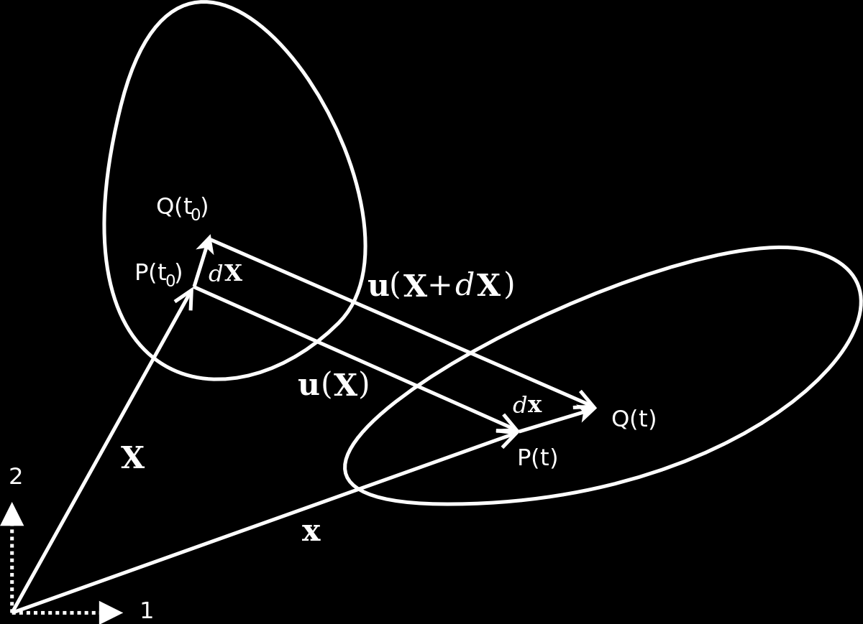
Strain imaging algorithm Strain: quantification of tissues’ mechanical distortion
Pre-deformation body
Post-deformation body
Displacement Images
Strain Images
Cardiac Cycle Accumulation
Strain Metrics
Notes:
40

Slide 41

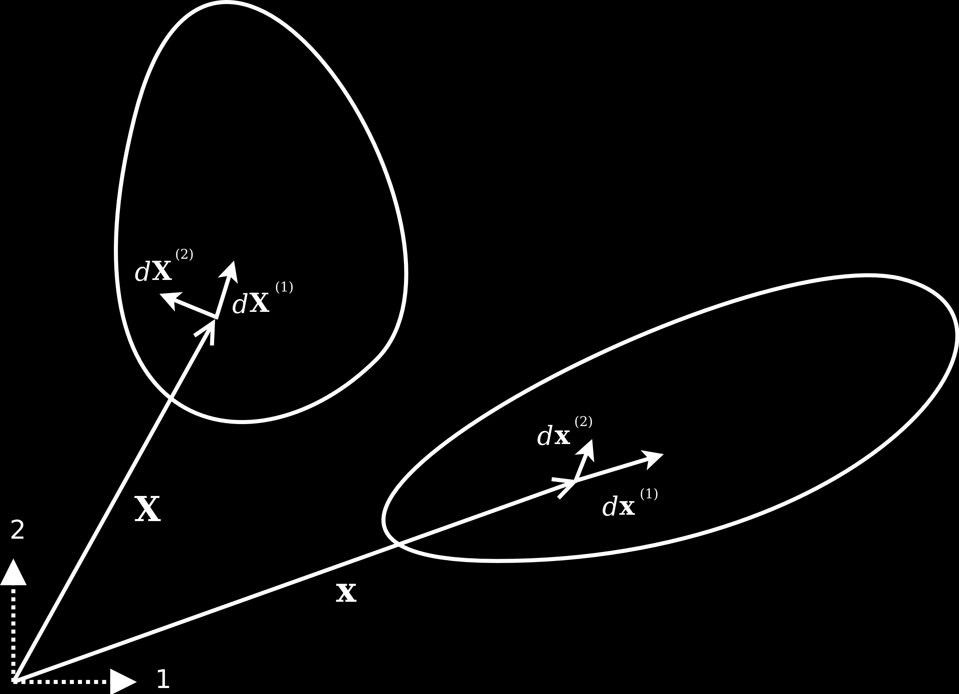



Strain imaging algorithm Strain: quantification of tissues’ mechanical distortion
Pre-deformation body
Green-Lagrangian strain:
Post-deformation body
Displacement Images
Strain Images
Eulerian-Almansi strain:
Cardiac Cycle Accumulation
Strain Metrics
Notes:
41

Slide 42
Strain imaging algorithm Physical interpretation of strain
Equation Implications
Interpretation:
Change in length, change in angle of differential segments
Displacement Images
Strain Images
Cardiac Cycle Accumulation
Strain Metrics
Notes:
42

Slide 43


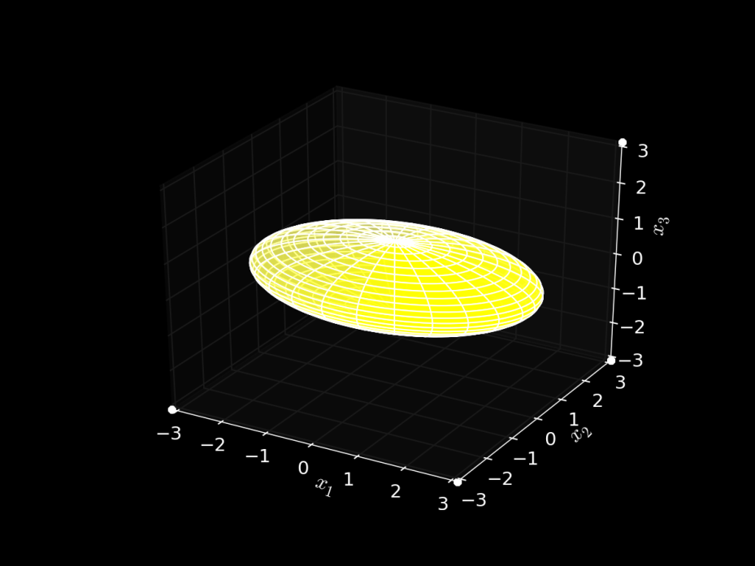
Strain imaging algorithm Ellipse representation of strain
Equation Implications
Diffusion Tensor MRI
Interpretation:
Change in length, change in angle of differential segments
Ellipse representation
Ellipsoid
Displacement Images
Strain Images
Cardiac Cycle Accumulation
Strain Metrics
Notes:
43

Slide 44
Strain imaging algorithm Ellipse representation of strain
Equation Implications
Diffusion Tensor MRI
Interpretation:
Change in length, change in angle of differential segments
Ellipse representation
Same quadric form
Real, symmetric: has Eigenvalues
Displacement Images
Strain Images
Cardiac Cycle Accumulation
Strain Metrics
Notes:
44

Slide 45
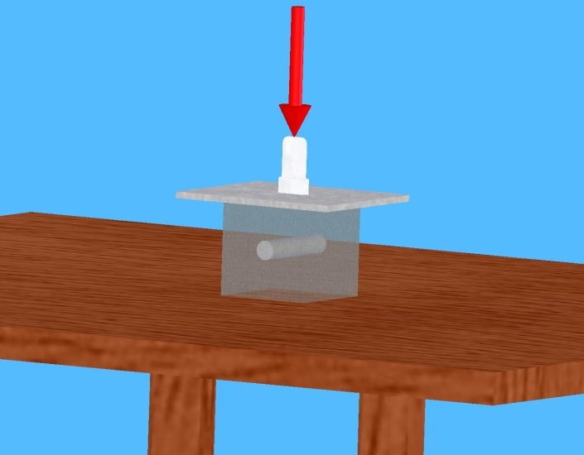
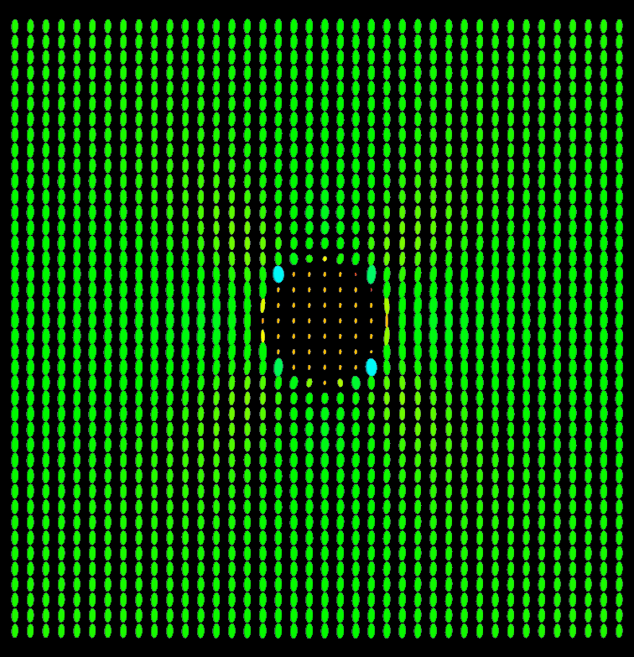
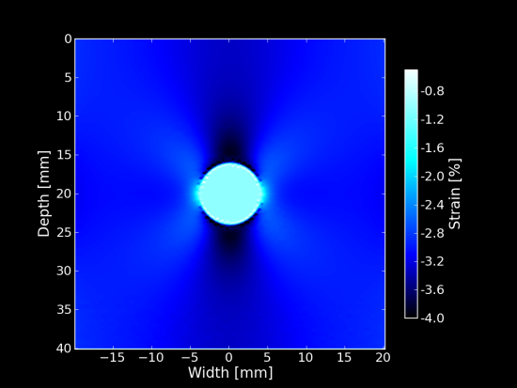
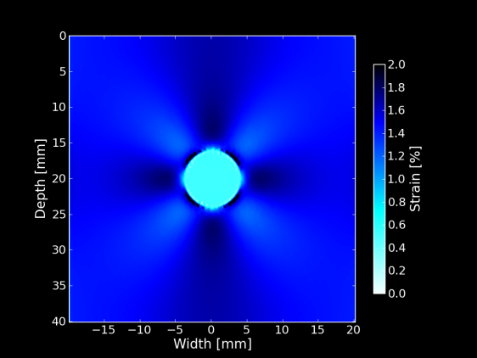
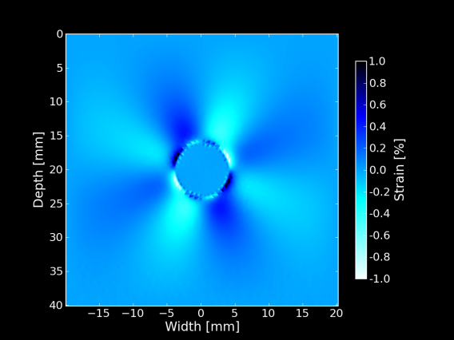
Strain imaging algorithm Ellipse representation of strain
Equation Implications
Interpretation:
Change in length, change in angle of differential segments
Ellipse representation
Displacement Images
Strain Images
Cardiac Cycle Accumulation
Strain tensor ellipses
Strain Metrics
Individual strain tensor components
Notes:
45

Slide 46

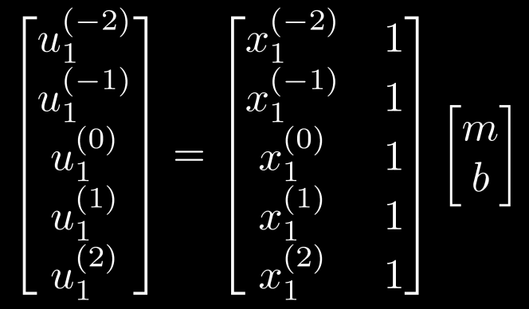

Strain imaging algorithm Displacement gradient calculation for noisy, discontinuous data
Equation Implications
Interpretation:
Change in length, change in angle of differential segments
Ellipse representation
Calculation:
Displacement gradients
Noisy
Local least-squares linear fit to estimate displacement gradients
Displacement Images
Strain Images
Cardiac Cycle Accumulation
Strain Metrics
Notes:
46

Slide 47
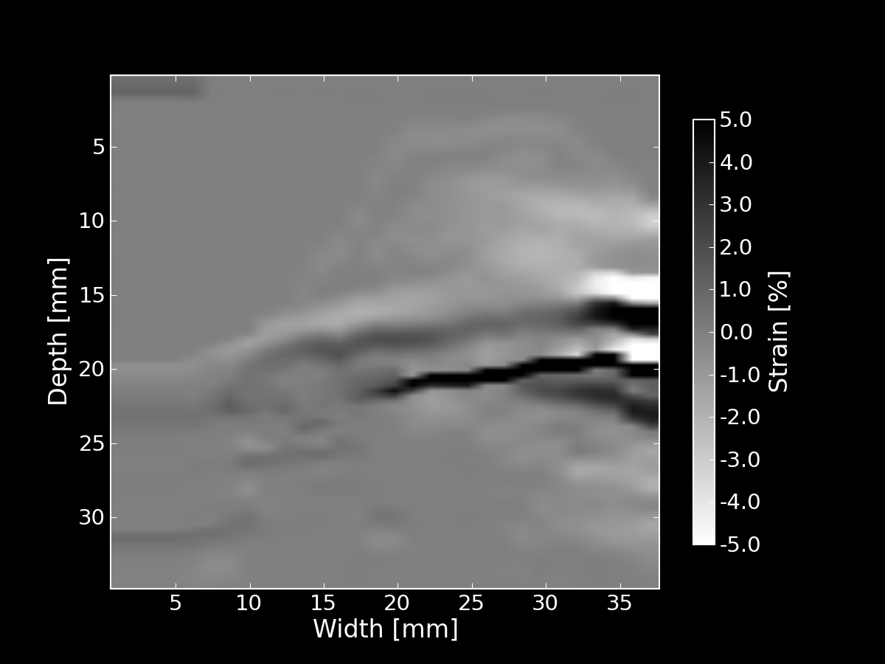
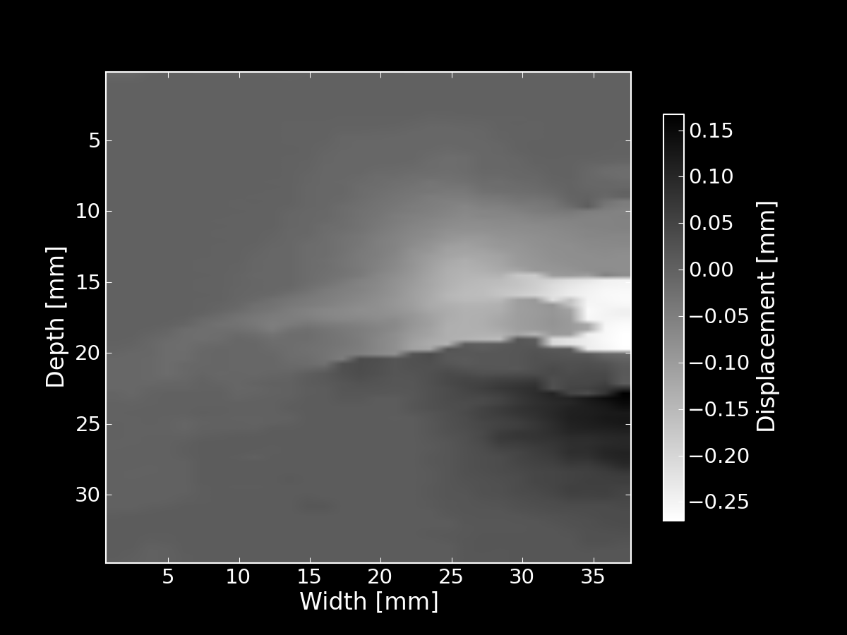
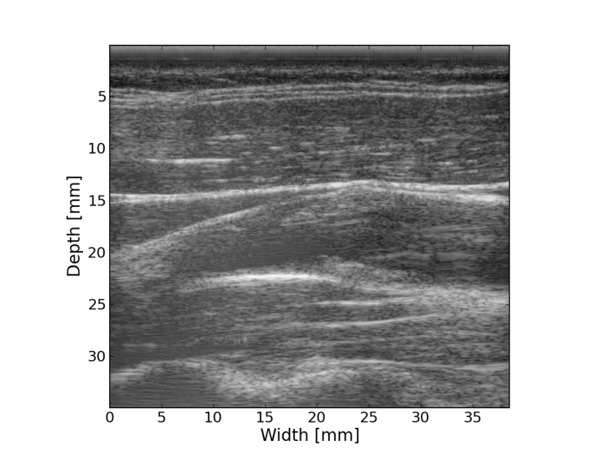
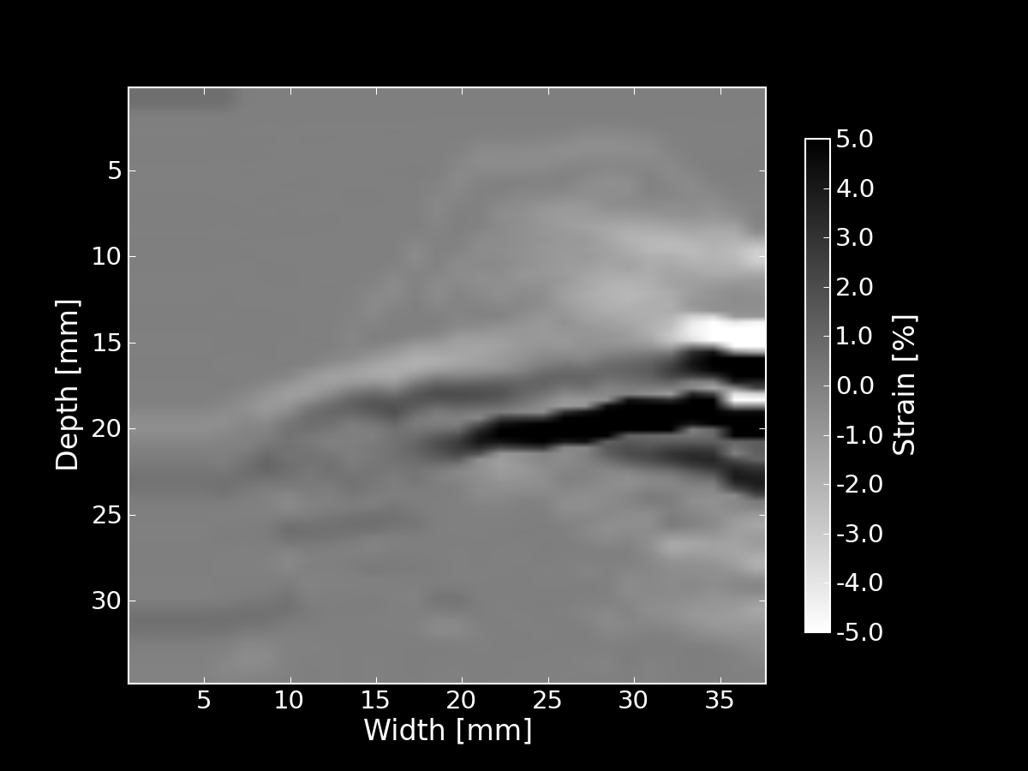
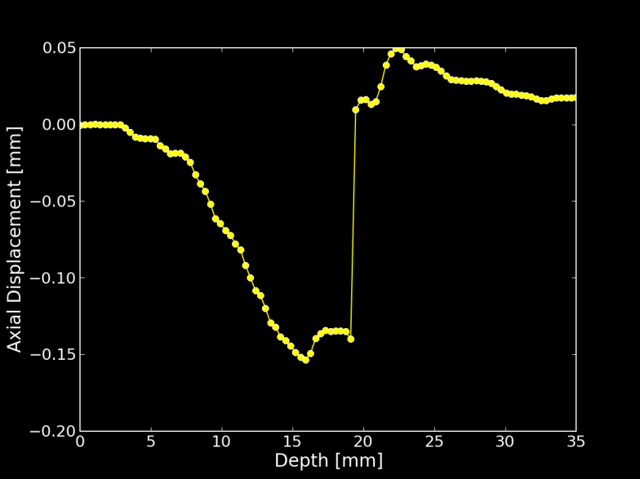
Strain imaging algorithm Displacement gradient calculation for noisy, discontinuous data
Equation Implications
Interpretation:
Change in length, change in angle of differential segments
Ellipse representation
Calculation:
Displacement gradients
Noisy
B-Mode
Axial displacement
Displacement Images
Strain Images
Cardiac Cycle Accumulation
Axial strain
Discontinuity corrected strain
Displacement along line
Strain Metrics
Notes:
47

Slide 48
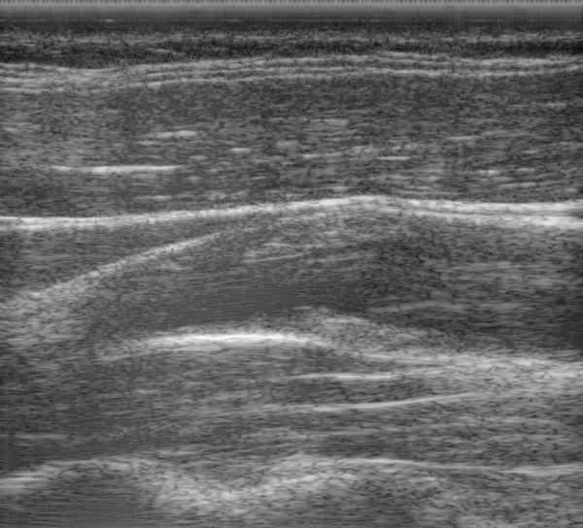


Strain imaging algorithm Strain over cardiac cycle
Pre-deformation body
Post-deformation body
Displacement Images
Strain Images
Cardiac Cycle Accumulation
Strain Metrics
Notes:
48

Slide 49


Strain imaging algorithm Accumulation of incremental Eulerian strain: particle approach
Calculate incremental displacements
Use dynamic frame skip
Right amount of motion for best motion-tracking
Accumulate incremental Eulerian strains
Diastole
Systole
Displacement Images
Strain Images
Cardiac Cycle Accumulation
Strain Metrics
Notes:
49

Slide 50
Strain imaging algorithm Accumulating strain over the cardiac cycle
The problem: tissue to accumulate over is moving
Displacements are generally not pixel multiples
The solution: accumulate on particles
Displacement Images
Strain Images
Cardiac Cycle Accumulation
Strain Metrics
Notes:
50

Slide 51


Strain imaging algorithm Accumulating strain over the cardiac cycle
B-Mode
Binary mask segmentation
Mesh segmentation
Displacement Images
Strain Images
Cardiac Cycle Accumulation
Strain Metrics
Notes:
51

Slide 52


Strain imaging algorithm Accumulating strain over the cardiac cycle
Pre-deformation
Post-deformation
Displacement Images
Strain Images
Cardiac Cycle Accumulation
Strain Metrics
Notes:
52

Slide 53

Strain imaging algorithm Accumulating strain over the cardiac cycle
Displacement Images
Strain Images
Cardiac Cycle Accumulation
Strain Metrics
Notes:
53

Slide 54




Strain imaging algorithm Tensor to scalar: yield criteria
Maximum principal strain
Maximum shear strain
Total strain energy
Displacement Images
Strain Images
Distortional energy
Cardiac Cycle Accumulation
Strain Metrics
Notes:
54

Slide 55
Strain imaging algorithm Scalar over cardiac cycle to single value
Peak-to-peak mean
Peak-to-peak 90th percentile
Peak-to-peak variance
All three of the above for the sum of the magnitude of the time derivative
Displacement Images
Strain Images
Cardiac Cycle Accumulation
Strain Metrics
Notes:
55

Slide 56
High frequency US characterization Overview
Notes:
56

Slide 57
Strain imaging algorithm Overview
Displacement Images
Strain Images
Cardiac Cycle Accumulation
Strain Metrics
Notes:
57

Slide 58

Aim 2: High frequency US characterization Preliminary results
Plaques are obtained immediately following endarterectomy.
They are placed in a water bath and suspended by catheter sheaths.
2 cm

Slide 59

Aim 2: High frequency US characterization Preliminary results
Plaques are obtained immediately following endarterectomy.
They are placed in a water bath and suspended by catheter sheaths.
Imaging is performed with a commercial VisualSonics 770 system.

Slide 60

Aim 2: High frequency US characterization Preliminary results
Plaques are obtained immediately following endarterectomy.
They are placed in a water bath and suspended by catheter sheaths.
Imaging is performed with a commercial VisualSonics 770 system.

Slide 61

Aim 2: High frequency US characterization Preliminary results

Slide 62
Aim 2: High frequency US characterization Preliminary results
Create images of the integrated backscatter coefficient.
The backscatter coefficient is backscattered power per solid angle per volume per incident intensity of a plane wave
Varies with frequency Integrate
Quantity that reflects material properties
Effective scatterer size
Acoustic impedance gradient
Scatterer density
Notes:
62

Slide 63


Aim 2: High frequency US characterization Preliminary results
Large plaque with excessive amount of thrombus and signs of inflammation on removal.
Ulcerated, complex morphology of the inner wall with soft, weak plaque and little calcification.
Likely unstable with recent rupture events.

Slide 64

Aim 2: High frequency US characterization Preliminary results
Notes:
64

Slide 65




Aim 2: High frequency US characterization Preliminary results
B Mode
Integrated Backscatter
3 mm
3 mm

Slide 66


Aim 2: High frequency US characterization Preliminary results
Long plaque composed primarily of fibrous tissue with dispersed calcified areas.
Smooth, regular inner wall.
Likely stable.

Slide 67
Aim 2: High frequency US characterization Preliminary results
Notes:
67

Slide 68




Aim 2: High frequency US characterization Preliminary results
B Mode
Integrated Backscatter
3 mm
3 mm

Slide 69


Aim 2: High frequency US characterization Preliminary results
Histology
Integrated Backscatter
Compare tissue composition areas identified in histology planes to the high frequency US and in vivo strain images.

Slide 70

Aim 3: Transcranial Doppler Preliminary results
Wish to validate the presence of microemboli in vivo to associate with plaque risk.
Cannot be detected in carotid ultrasound because of resolution and coverage issues.
Transcranial Doppler monitoring of middle cerebral artery.

Slide 71
Aim 3: Transcranial Doppler Preliminary results
Collect continuous velocity data for 1 hour immediately following carotid ultrasound.
Reviewed by three trained observers.
High Intensity Transient Siignals (HITS) count >= 1/hour associated with increased stroke risk.
Notes:
71

Slide 72


Aim 3: Transcranial Doppler Preliminary results
Microemboli indicated by high intensity transient signal (HITS)
Lasts < 300 ms
Intensity at least 3dB higher than background
Unidirectional in velocity
Unilateral
Audible ‘snap’, ‘chirp’, or ‘moan’

Slide 73

Aim 3: Transcranial Doppler Preliminary results
Custom software to address analysis challenges.
Peak of velocity envelope saved to search for HITS criteria.
Unilateral velocity spikes on curve
Machine detected intensity spikes displayed as points
Marks made during acquisition that reflect motion and velocity profile status.
Velocity
Time

Slide 74
Aim 1: In vivo carotid strain imaging Research Design
Presently we have in vivo carotid ultrasound data from 27 patients.
Measurements are made transverse and longitudinally at the common carotid artery (CCA), bulb, internal carotid artery (ICA), and external carotid artery (ECA).
Recent and future data collection methods have been improved:
Measurements are made of the plaque’s extent from the tip of the flow divider to termination in ICA and CCA.
Bilateral collection of radiofrequency data.
Beam steering.
Reduce scan time.

Slide 75




Aim 1: In vivo carotid strain imaging Research Design
Improve previously proposed multi-level motion tracking algorithm.
Reliably quantify lateral motion. The enables examination of strain indices other than the maximum accumulated axial strain, such as
maximum principal strain,
maximum shear strain,
total strain energy,
distortional strain energy,
Numerous levels and careful filtering to prevent aliasing
Estimator that combines matching criteria performance at each level.

Slide 76
Aim 2: High frequency US characterization Research Design
There have been previous efforts to create integrated backscatter images, but all used the planar reflector method.
We propose the use of the reference phantom method, but it requires a stable, well characterized reference phantom with acoustic properties similar to plaque.
We have to quantify
Attenuation
Alignment, play, small spaces
Signal attenuation and sampling rate
Water attenuation and Saran transmission coefficient
Absolute backscatter coefficient
Attenuation and alignment
Measure transducer effective aperture and focus

Slide 77
Aim 2: High frequency US characterization Research Design
Compare tissue composition areas to histology.
Concatenate volumetric slices.
Obtain second set of data with plaque rotated about the catheter to validate integrated backscatter images.
Diffraction changes
Electronic noise changes
Pulse attenuation history changes

Slide 78
Aim 3: Transcranial Doppler Research Design
Patients examined with TCD following US carotid examination and following surgery.
Reliability of measurements.
Rule out alternate sources of emboli.
Validates strain imaging along with
Asymptomatic/symptomatic history
Histology
High frequency ultrasound
MRI imaging of ischemic cerebral tissue and volumetric atrophy
Cognitive performance testing.

Slide 79
Timeline
Aim |  | Year 1 |  |  |  | Year 2
1 | Carotid plaque strain imaging for stroke risk assessment | X | X | X | X | X | X | X | X
2 | In vitro high frequency plaque characterization | X | X | X | X
3 | Transcranial Doppler detection of microemboli | X | X | X | X | X | X | X | X

Slide 80
Acknowledgements
Committee members
- Dr. Robert Dempsey
- Dr. Timothy Hall
- Dr. Mark Kliewer
- Dr. Elizabeth Meyerand
- Dr. Tom Yin
- Dr. Tomy Varghese
- Dr. James Zagzebski
Phantom Experts
- Dr. Ernest Madsen
- Gary Frank
- Meagan Deaner
Ultrasonographers
- Dr. Carol Mitchell
- Sara Baker
- Bridgett Finnegan
Visualsonics
- Dr. Tim Hacker
- Dr. Tim Stiles
Research coordination
- Pam Winne
- Cindy Colombo
- Niki Virnig
Pathology
- Dr. Shahriar Salamat
Condor
- Dr. Orhan Unal
- Xiaohu Mo
- Dr. Michael Kissick
- Bill Taylor
- Yacouba Traore
UW-THW
- Dr. Nicholas Preston
- Dr. Paul Wilson
- Dr. Milad Fatenejad
- Dr. Matthew Terry
- Anthony Scopatz
- Katy Huff
- Rachel Slaybough
- Aronne Merrelli
- Royal Elmore
…
Dept. Administrators
- JoAnn Kronberg
- Beth Bierman
- Anne Duchek
Ultrasound group members
- Dr. Hairong Shi
- Dr. Maritza Hobson
- Dr. Jingfeng Jiang
- Dr. Miklos Kiss
- Dr. Ted Fisher
- Dr. Dave Duncan
- Xiao Wang
- Kibo Nam
- Ryan DeWall
- Nick Rubert
- Matthew Bayer
- Haiyan Xu
- Eenas Omari
- Lisa Reusch
- Chi Ma
- Wenqi Ge
- Kayvan Samimi
- Eric Nordberg
- Dr. Jihad Al-Sadah
- Ivan Rosado-Mendez
- Lindsey Carlson
- Janelle Anderson
- Theo Pavan
Medical Physics Graduate Students, Faculty, and Scientists
Roommates
- Michael Tomkowiak
- Matthew Nyflot
- Armando Ibarra
Family
- Parents, Dr. Michael and Bernadette McCormick
- Siblings, Erin, Paul, Ryan, Rebecca, Sean
- Uncle, Patrick and Sara McCormick, and cousins
5-Hour Energy

Slide 81
Related Pathologies: Different intensities and time courses
Transient ischemic attacks (TIA) are cerebral impairment that subside in under 24 hours, which often precede a stroke.
Recent evidence has correlated microemboli that may cause chronic ischemic burden with dementia in Alzheimer’s.
A correlation has also been observed between migraine and ischemic stroke.

Slide 82
Current methods for assessing Risk
Currently, stenosis >70% qualifies a patient for endarterectomy.
With this assessment method, only 16% of patients that have a carotid endarterectomy benefit from surgery¹.
¹P.M. Rothwell and C.P Warlow. Prediction of benefit from carotid endarterectomy in individual patients: a risk-modeling study. European Carotid Surgery Trials’ collaborative group. Lancet, 353 (9170): 2105-2110, Jun 1999.

Slide 83
Methods being investigated to assess Risk
Image plaque composition.
Ultrasound
MRI
Image markers of inflammation.
PET
Catheter based methods
Image ulceration or vasa vasorum.
Angiography
Ultrasound
MRI

Slide 84

Power Mode Doppler
Notes:
84

